Slide 1





WYZZ MEDICAL
PROFILE
WYZZ MEDICAL
WYZZ
MEDICAL
Pitch Deck 2024

Slide 2



WYZZ MEDICAL
ABOUT
Wyzz Medical
Pitch Deck 2024
Wyzz Medical is a global leader in the healthcare industry, specializing in high-quality disposable products, surgical instruments, and medical equipment. With decades of experience and a robust global network, we are dedicated to innovation, quality, and customer satisfaction. Our comprehensive product line meets the highest standards and regulations, ensuring reliability and safety for healthcare professionals and patients alike. At Wyzz Medical, we combine competitive pricing with exceptional service, making us the trusted partner for all your medical needs. Discover the Wyzz Medical difference and elevate your healthcare solutions with confidence.

Slide 3

Company
Purpose
WYZZ MEDICAL
At Wyzz Medical, our mission is to enhance healthcare outcomes globally by providing high-quality disposable products, surgical instruments, and medical equipment. We are committed to innovation, excellence, and customer satisfaction, ensuring that our products meet the highest standards and regulations. Through our extensive experience and robust global network, we strive to deliver reliable and cost-effective solutions that support healthcare professionals in providing the best possible care. At Wyzz Medical, we aim to be a trusted partner, dedicated to improving patient health and safety worldwide.
Pitch Deck 2024

Slide 4

Company Vision
WYZZ MEDICAL
Wyzz Medical envisions a world where superior healthcare is accessible to all, supported by innovative, reliable, and high-quality medical products. We strive to be at the forefront of healthcare solutions, continually advancing our offerings to meet the evolving needs of medical professionals and patients globally. Our commitment is to drive excellence, enhance patient outcomes, and set new standards in the healthcare industry.
Global Reach and Network:
Pitch Deck 2024
Leveraging decades of experience and extensive contacts in the medical field to provide top-tier healthcare solutions worldwide.
Comprehensive Product Line:
Offering a wide range of high-quality disposable products, surgical instruments, and medical equipment, ensuring reliability and safety.
Competitive Pricing and Exceptional Service:
Delivering cost-effective solutions without compromising on quality, backed by outstanding customer support and personalized service.

Slide 5

Products
WYZZ MEDICAL
Wyzz Medical offers a comprehensive range of high-quality disposable medical products designed to meet the rigorous demands of modern healthcare. Our products are crafted with precision, ensuring reliability and safety for both healthcare professionals and patients. We prioritize innovation, sustainability, and ease of use, providing solutions that enhance clinical efficiency and patient care.
  Surgical Instruments: Offering high-precision surgical tools designed for reliability, safety, and optimal performance in the operating room.
  Medical Equipment: Featuring advanced devices and tools essential for diagnostics, treatment, and patient monitoring.
  Disposable Products: Including IV lines, needles, blood transfusion supplies, and various disposable bags for medical use.
Pitch Deck 2024

Slide 6




Our
Services
Training
RMA
Wyzz Medical provides comprehensive training on all equipment, ensuring healthcare professionals are fully equipped to use our products effectively and safely.
We offer a seamless Return Merchandise Authorization (RMA) process to facilitate easy product replacements or returns.
WYZZ MEDICAL
At Wyzz Medical, exceptional service is our priority. We ensure prompt delivery, seamless integration, and comprehensive support for all our products. Our dedicated customer care team is always available to assist with any inquiries and provide guidance. We also offer a straightforward Return Merchandise Authorization (RMA) process, making it easy to return or exchange products if necessary. Trust Wyzz Medical for reliable service and unwavering support in every aspect of your healthcare needs.
Pitch Deck 2024
Committent
We are committed to providing exceptional service, ensuring seamless product replacements or returns to support our customers' needs effectively.

Slide 7
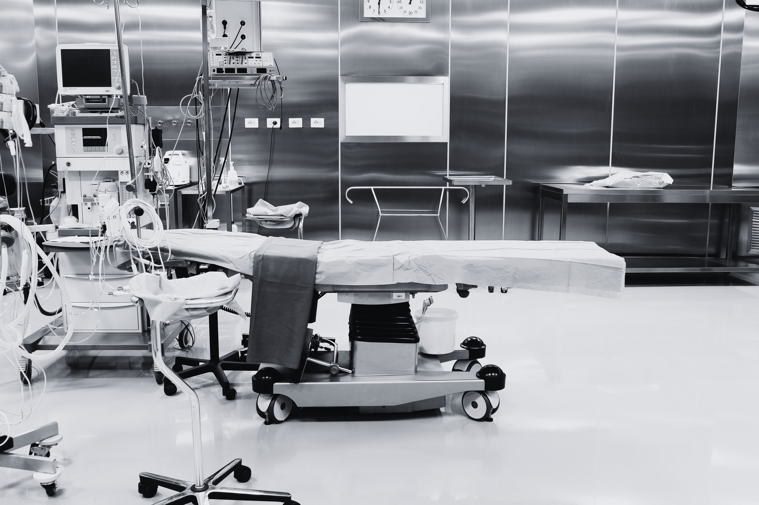
Industry Values
WYZZ MEDICAL
Technology
Innovating advanced medical solutions for improved patient care.
Quality
Ensuring top-tier products that meet stringent industry standards.
Pitch Deck 2024
Safety
Prioritizing patient and provider safety in all our designs.

Slide 8


Financial
Horizon
WYZZ MEDICAL
Pitch Deck 2024
Strong Market Growth:
Innovation Driven
Projected annual growth rate of 7% in the medical disposables sector.
Attractive investment opportunity, promising both stability and growth.

Slide 9

Sustainability
is part of our
purpose.
WYZZ MEDICAL
At Wyzz Medical, we believe in the power of social responsibility and community engagement. Through charitable initiatives and active participation in community projects, we strive to make a positive impact on society. Our commitment to empowerment extends beyond our products and services to uplifting communities, supporting education, healthcare, and environmental sustainability. By investing in social initiatives, we aim to create a brighter, healthier future for all. Join us in our journey towards meaningful social change and collective empowerment.
Pitch Deck 2024
Social Responsibility.

Slide 10


Thank You.
WYZZ MEDICAL
Pitch Deck 2024
Contact us for More.
Phone
Email
Website
+31 85 0477700
info@wyzzmedical.com
www.wyzzmedical.com

